Slide 1
Cybersecurity Challenges to Critical Infrastructure Systems
Andre Salgado
CISO

Slide 2
Why Discuss Cyber?
Cybersecurity Market¹
Cost of Cybercrime²
Cybersecurity Market components: Software, Hardware, and Services
Growth Rate 8.9%/Year
Global cybercrime to grow 15%/Year
1 – Source: Markets and Markets
2 – Source: Cybersecurity Ventures
Notes:
https://www.marketsandmarkets.com/Market-Reports/cyber-security-market-505.html?gclid=CjwKCAjw8ZKmBhArEiwAspcJ7h_487S4973K25v1XX6z_VkCMksebf_Zrh1hRgPreKdnWgjs30TZ8RoC5XsQAvD_BwE
https://cybersecurityventures.com/hackerpocalypse-cybercrime-report-2016/

Slide 3
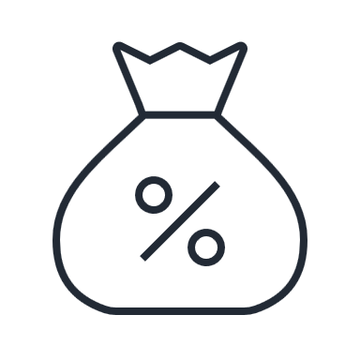
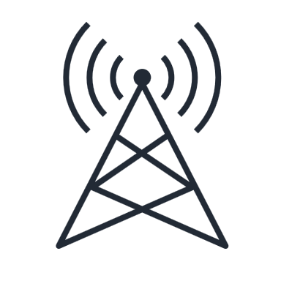
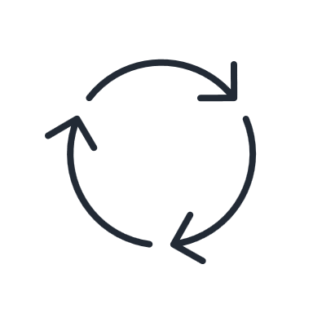
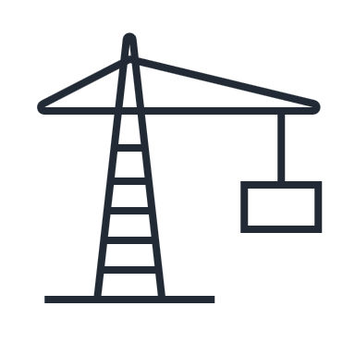
What is Critical Infrastructure?
FINANCE
TELECOM
UTILITIES
GOVERNMENT / STATE
MILITARY
AIR TRAFFIC
AGRICULTURE
OIL REFINERY

Slide 4
Examples
2010
FEB 2021
JUN 2021
JUN 2022
Stuxnet
Designed to destroy the centrifuges Iran was using to enrich uranium as part of its nuclear program and has since mutated and spread to other industrial and energy-producing companies.
Florida Water Supply
A Hacker tried to poison a Florida City's Water Supply, the attacker upped sodium hydroxide to extremely dangerous levels.
JBS
Computer networks were hacked, temporarily shutting down some operations in Australia, Canada and the US, the world's largest meat processing company has paid the equivalent of US $11MM ransom to put an end to the cyber-attack.
Costa Rica
an extensive cyberattack disrupted the Costa Rican government, cybercriminals started by attacking eight Costa Rican institutions, taking down internal systems and kidnapping their data in exchange for a ransom of $10 million.
Wannacry/Petya/Not Petya
Global endemic ransomware outbreak that took place in May/Jun 2017, the attack spread through computers operating Microsoft Windows.
Colonial Pipeline
One of the largest and most vital oil pipelines in the U.S suffered a Ransomware attack in May 2021. It infected some of the pipeline's digital systems, shutting it down for several days.
Ukraine
A hack of the Defense Ministry, army and state banks was the largest of its kind in Ukraine’s history, the primary targets were government websites, energy and telecom service providers, financial institutions, and media outlets, but encompassed most critical sectors.
2017
MAY 2021
FEB 2022
Notes:
1) Stuxnet: designed to destroy the centrifuges Iran was using to enrich uranium as part of its nuclear program nd has since mutated and spread to other industrial and energy-producing (2010)
2) Wanna Cry / Petya / Not Pettya: Global endemic ransomware outbreak that took place in May/Jun 2017, the attack spread through computers operating Microsoft Windows.
3) Florida Water: A Hacker tried to poison a Florida City's Water Supply, the attacker upped sodium hydroxide to extremely dangerous levels. Feb 2021
4) Colonial Pipeline: one of the largest and most vital oil pipelines in the U.S suffered a Ransomware attack in May 2021. It infected some of the pipeline's digital systems, shutting it down for several days.
5) JBS: Computer networks at were hacked in June 2021, temporarily shutting down some operations in Australia, Canada and the US. the world's largest meat processing company has paid the equivalent of US $11MM ransom to put an end to a major cyber-attack.
6) Ukraine: A hack of the Defense Ministry, army and state banks was the largest of its kind in Ukraine’s history, the primary targets were Ukrainian government websites, energy and telecom service providers, financial institutions, and media outlets, but the cyberattacks encompassed most critical sectors. Feb 2022
7) Costa Rica Government: an extensive cyberattack disrupted the Costa Rican government, cybercriminals started by attacking eight Costa Rican institutions, taking down internal systems and kidnapping their data in exchange for a ransom of $10 million. June 22

Slide 5
Challenges to Protect
1
4
Industrial Control Systems
Tipically depending on EoVS /
Legacy System
2
5
Not designated to be connected to a Network
Running on non-segmented Networks
3
6
Even less Internet
“Don’t touch until breaks” Approach

Slide 6
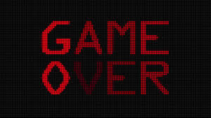
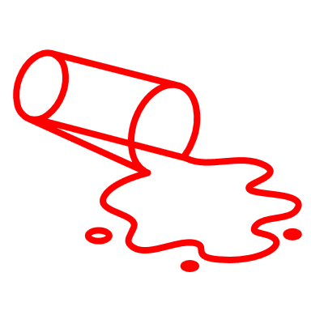
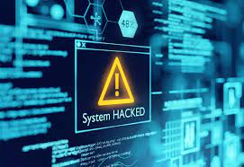
So, is that it?
CHAOS!
HASTA
LA
VISTA
BABY!
THE END

Slide 7
How to Reduce Risk?
Reduce Obsolete Software
Improve your detection
It’s about reducing
Risk Surface
Review need for (over) connectivity
Are you sure your Recovery works?
Reduce Privileged Entitlements
Train your Response
Make your Network less Flat
(Invest in Segmentation)

Slide 8
When should I start?
Now!
Actually you cannot wait until Monday.
Before your Bad Cyber Day comes...
Trust me, it will come, or
It will come again, or
Maybe it has come and, you haven’t noticed yet

Slide 9
Who is responsible for Cyber?
Cybersecurity should not be seen as IT responsibility
Must be at C-Level
The “C” in CISO must be for real
CEO ultimate accountable
Regulators expecting effective Board oversight / expertise
SEC may require public companies to appoint a Board member for cyber

Slide 10
Thank you! Gracias! Obrigado!

