Slide 1
Artificial Intelligence and Cyber Security: Cyber Resiliency
Fernando Arenas – LAN Edge Sr. BDM
Americas International
farenas@fortinet.com / +52 55 31293601 / @hubfer

Slide 2
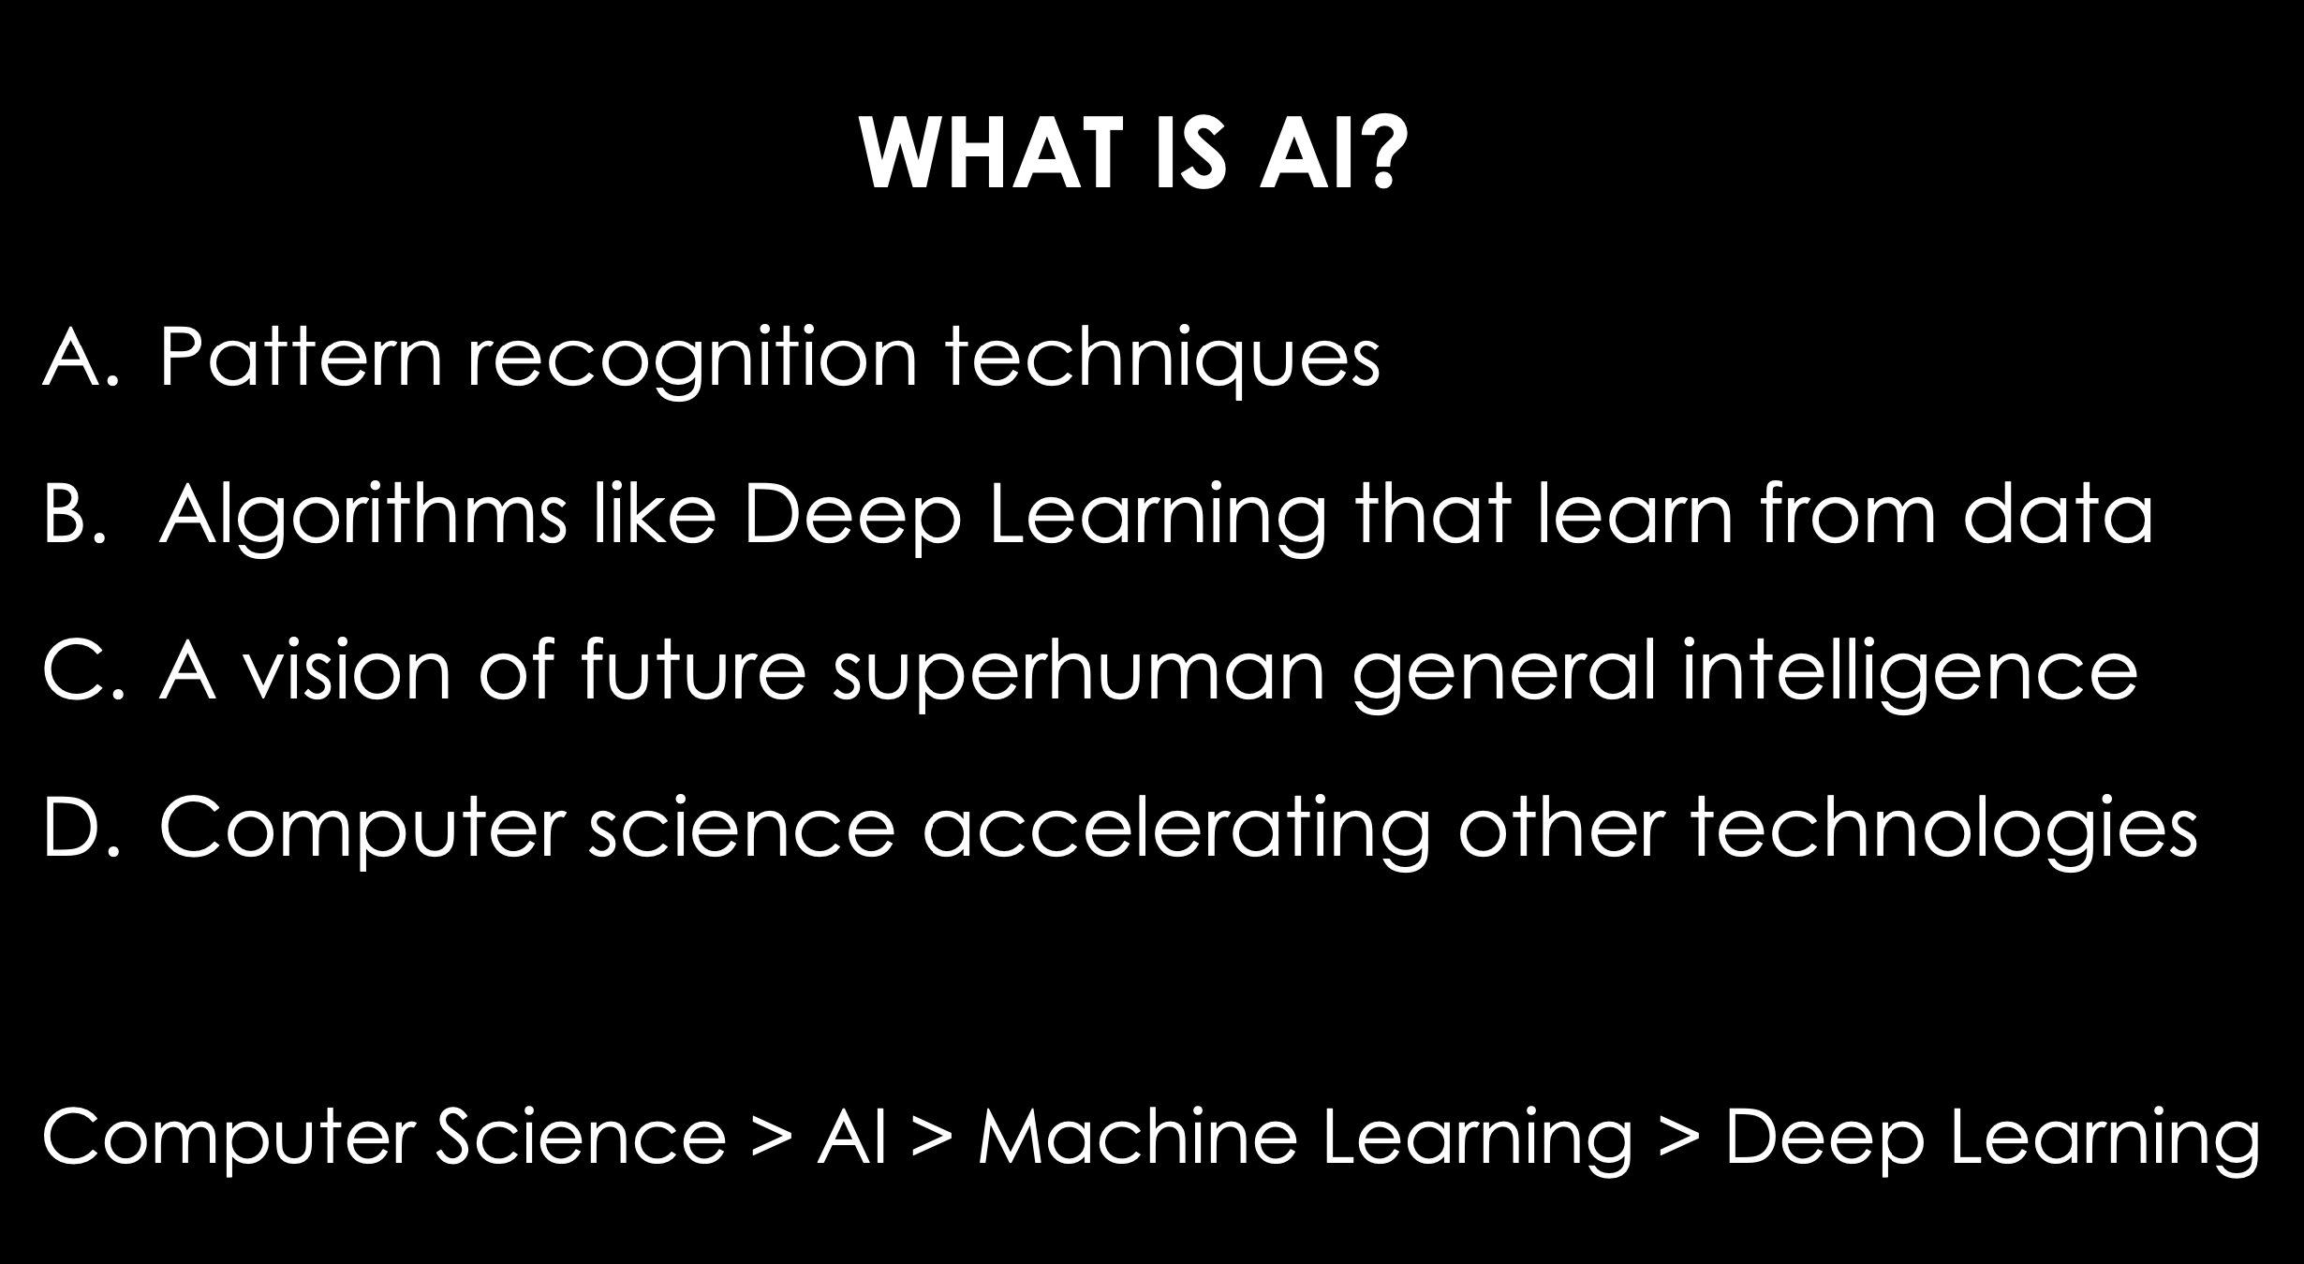
Long Term Strategic Trends and Technologies
Artificial Intelligence

Slide 3
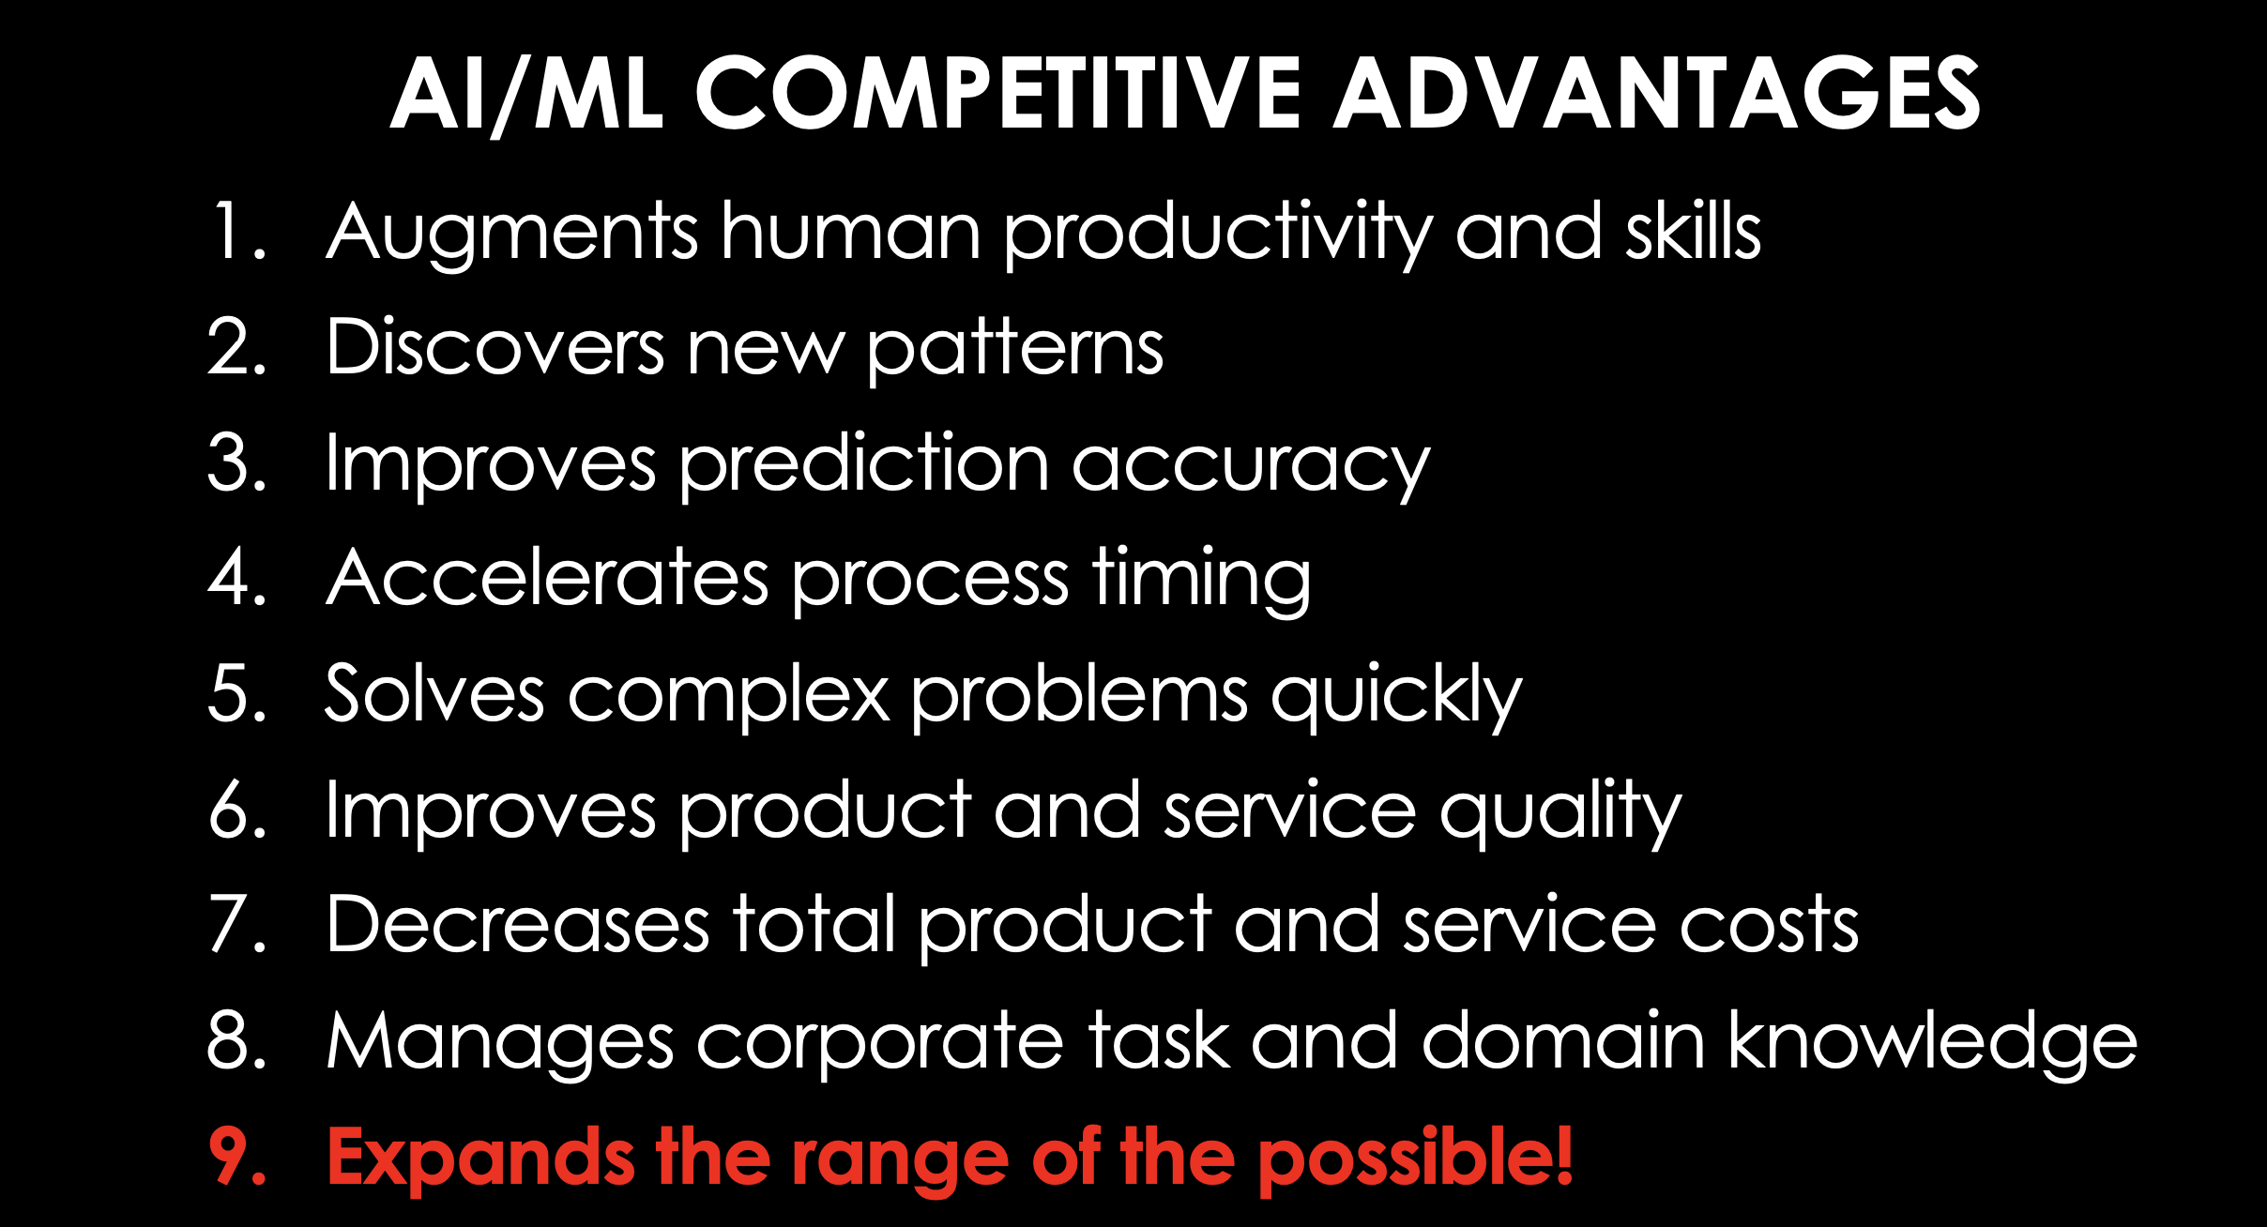
Long Term Strategic Trends and Technologies
Artificial Intelligence

Slide 4
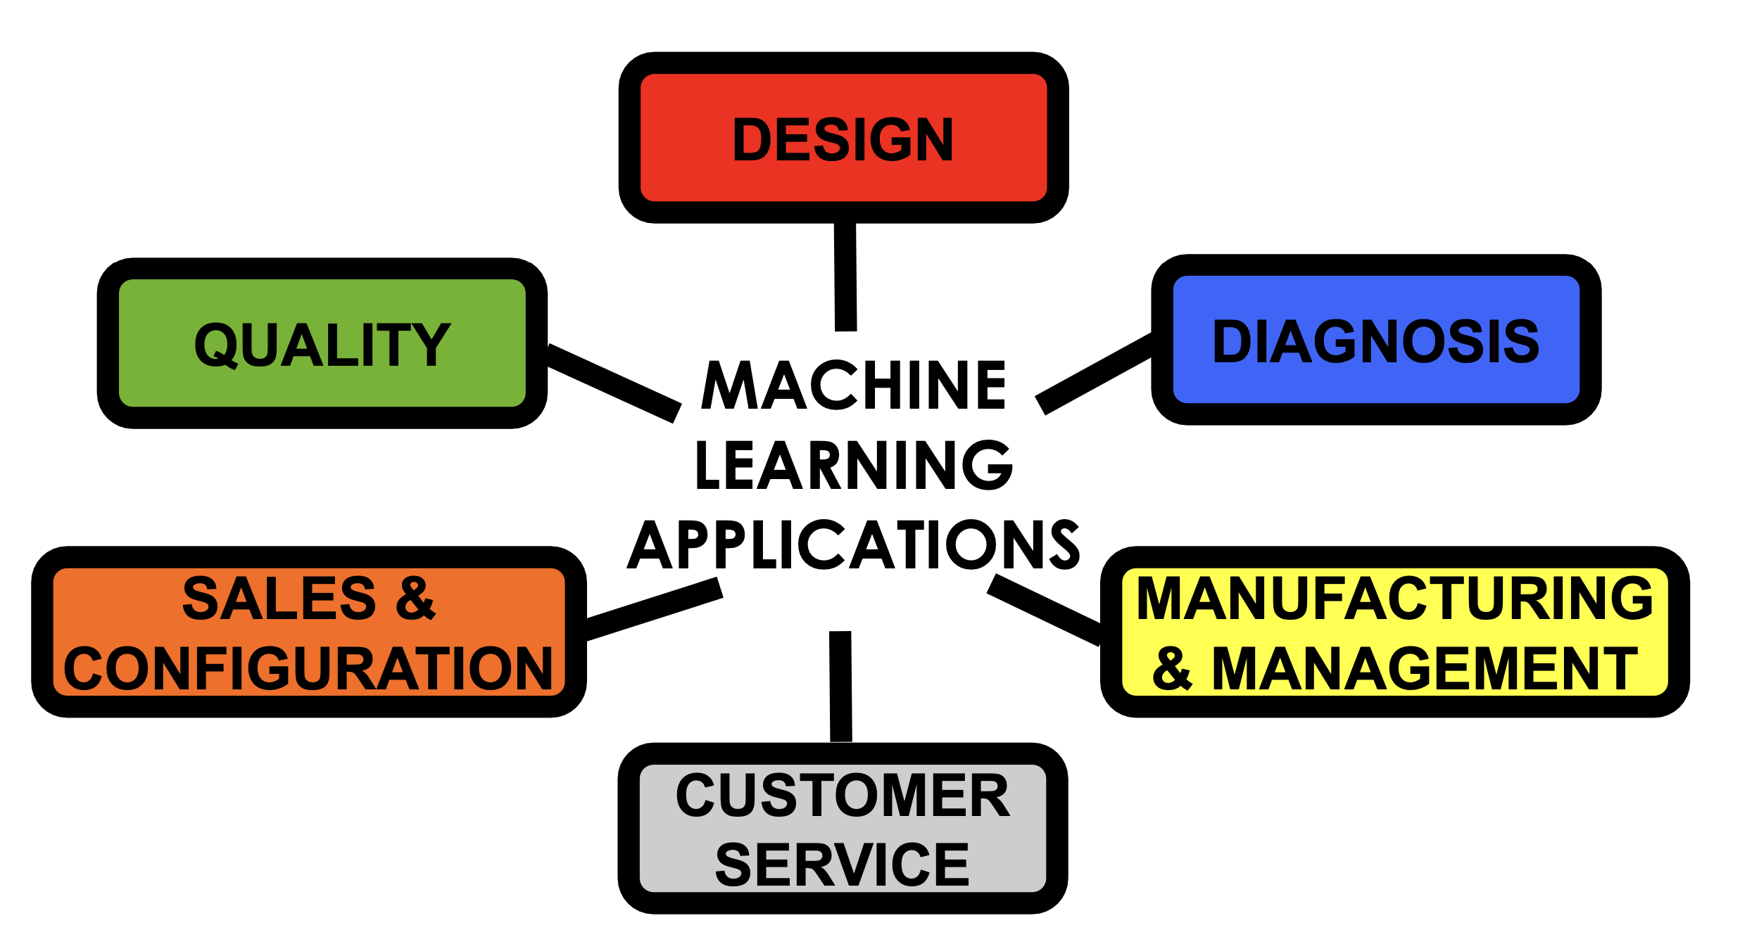
Long Term Strategic Trends and Technologies
Artificial Intelligence: What can do today?

Slide 5
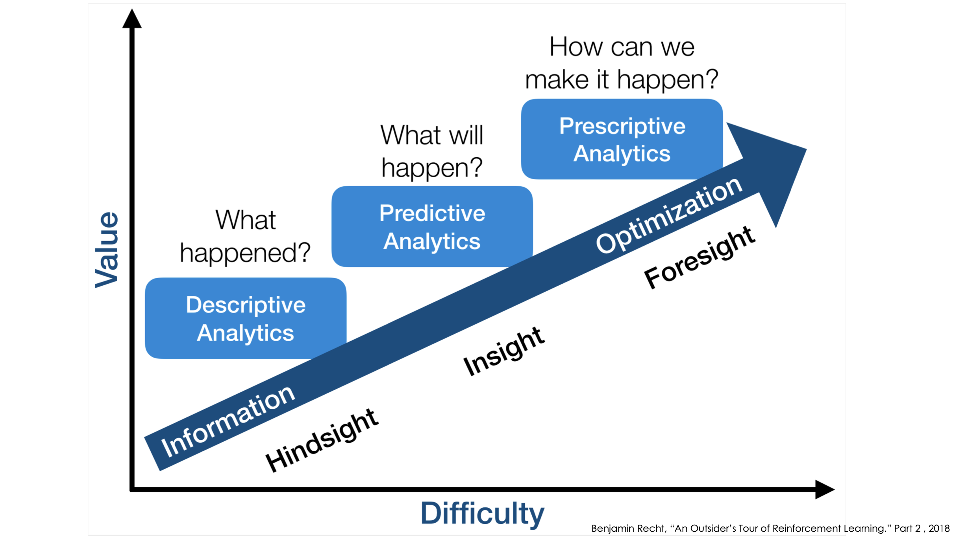
Long Term Strategic Trends and Technologies
Artificial Intelligence: Future Capabilities

Slide 6

Long Term Strategic Trends and Technologies

Slide 7
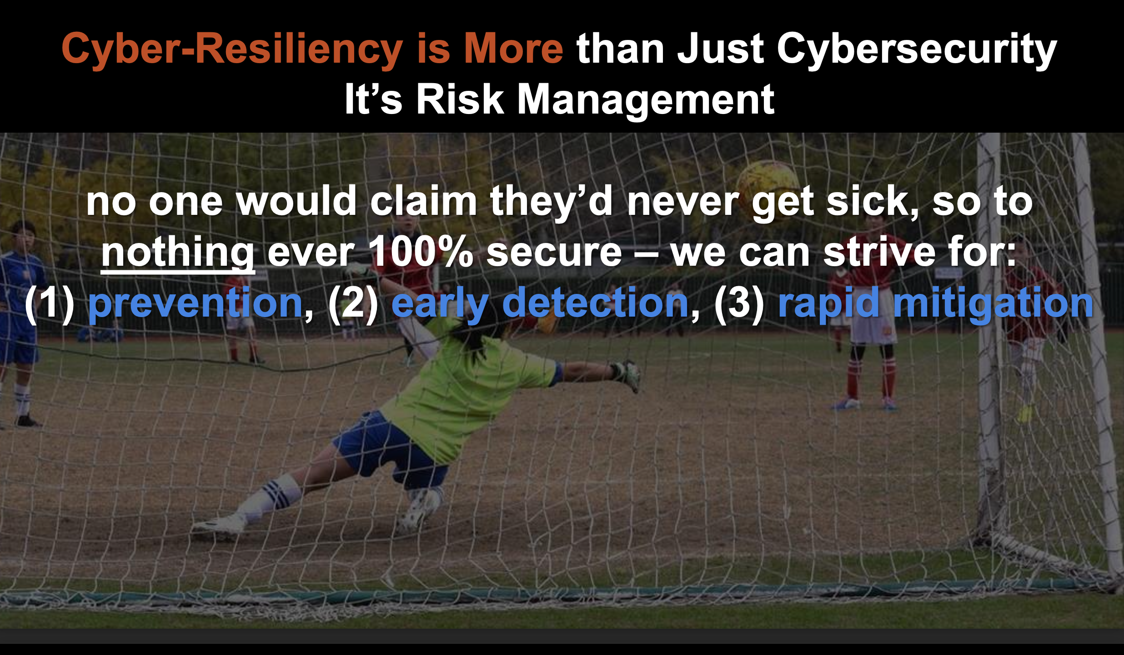
Business Continuity
Cyber Resilience: Cyber Security + Artificial Intelligence + Management + Convergence

Slide 8
Long Term Strategic Trends and Technologies
DONE
Reduced Complexity and Rapid Response: Cyber Resilience
Threat Landscape: PREVENTION
Convergence of Networking
and Security: DETECTION
Consolidation of Security
Point Product Vendors: MITIGATION
Vendor
A
Weaponization
of AI
Vendor
B
Advanced
Persistent
Cybercrime
Security-Driven Networking
Cybersecurity
Platform Approach
Networking
Security
Vendor
C
Vendor
N
Proof points: Gartner Enterprise Networking Market Forecast
Proof point: Gartner Cybersecurity MESH Architecture

Slide 9




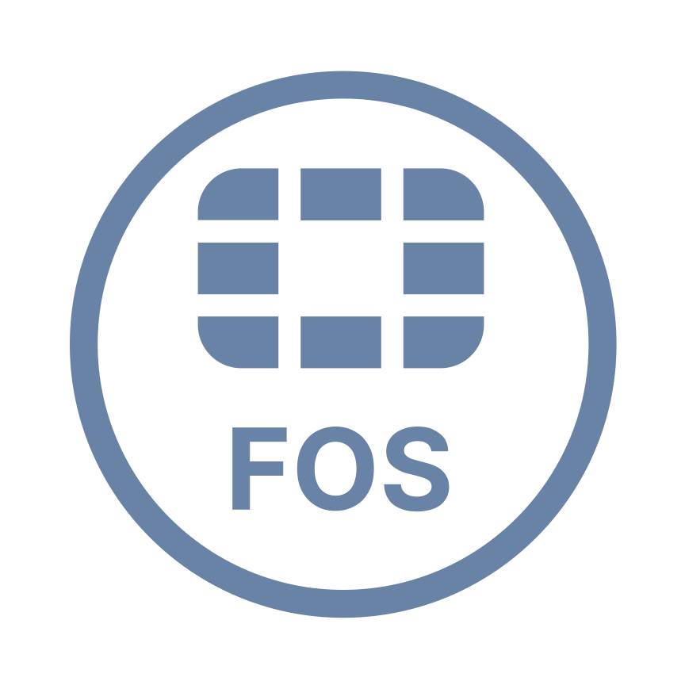














Convergence of AI, Networking and Security
Same Platform Everywhere
Actionable Threat Intelligence
Management
Networking
Security
5G
ZTNA Proxy
Ethernet Controller
Firewall
Segmentation
SWG
SD-WAN
Router
IPS
SSL
NAC
AP Controller
A
B
C
1
2
3
Appliances
Lack Awareness
Software
Delivers Network Awareness
Appliance
Virtual
Container
SaaS

Slide 10
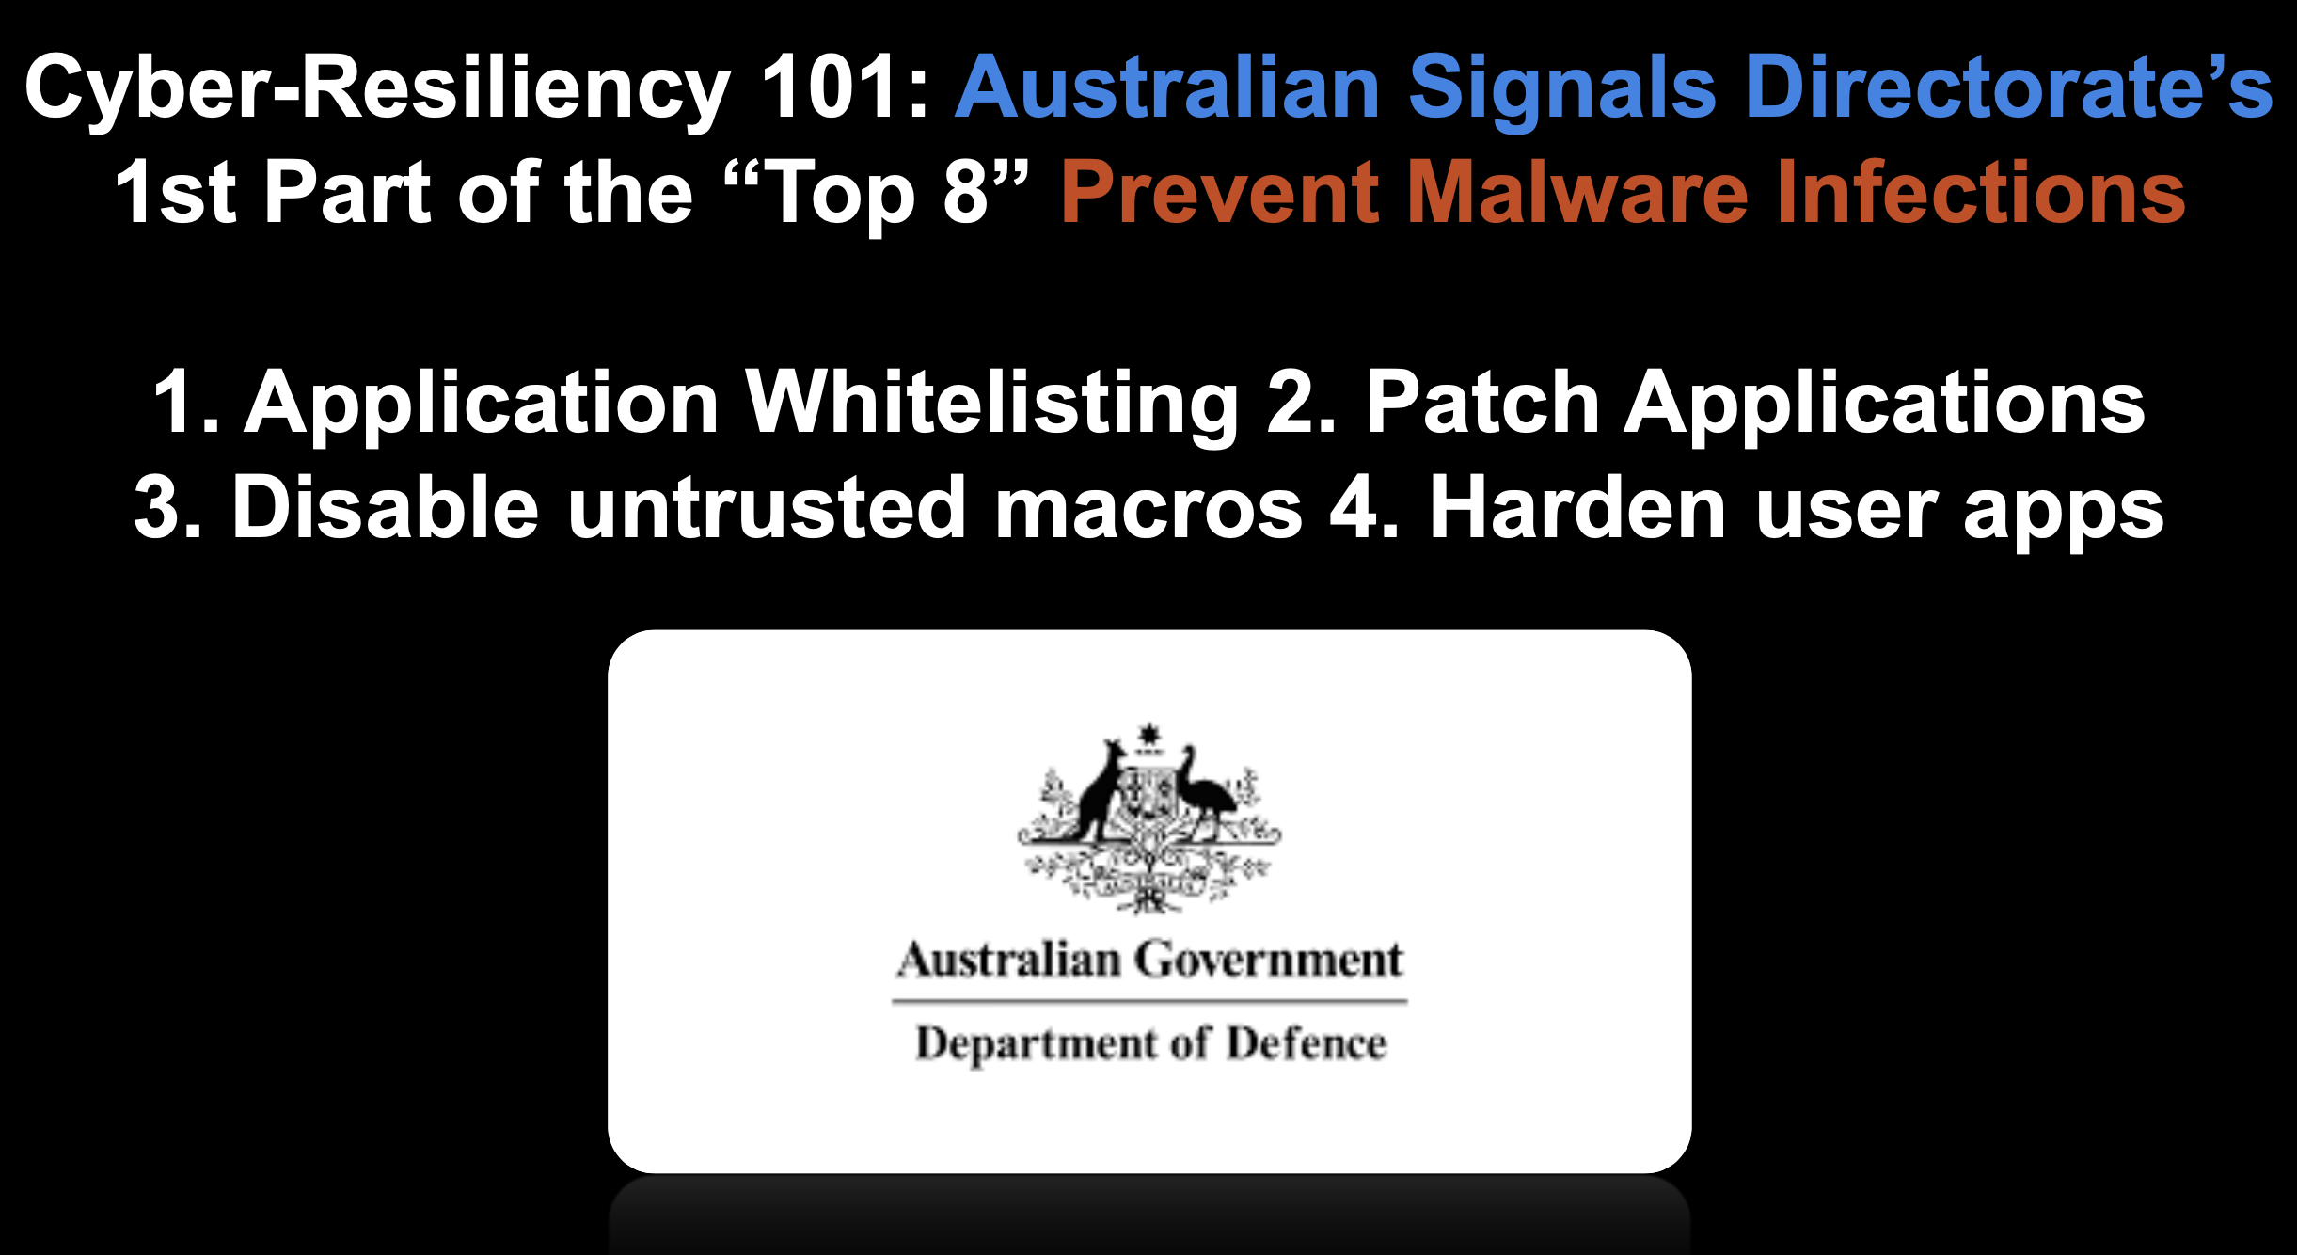
Long Term Strategic Trends and Technologies
Cyber-Resilience Primer

Slide 11
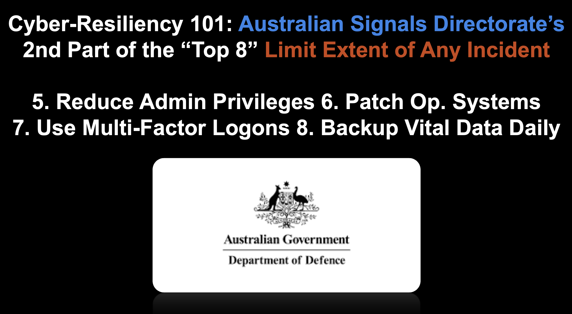
Long Term Strategic Trends and Technologies
Cyber-Resilience Primer

Slide 12
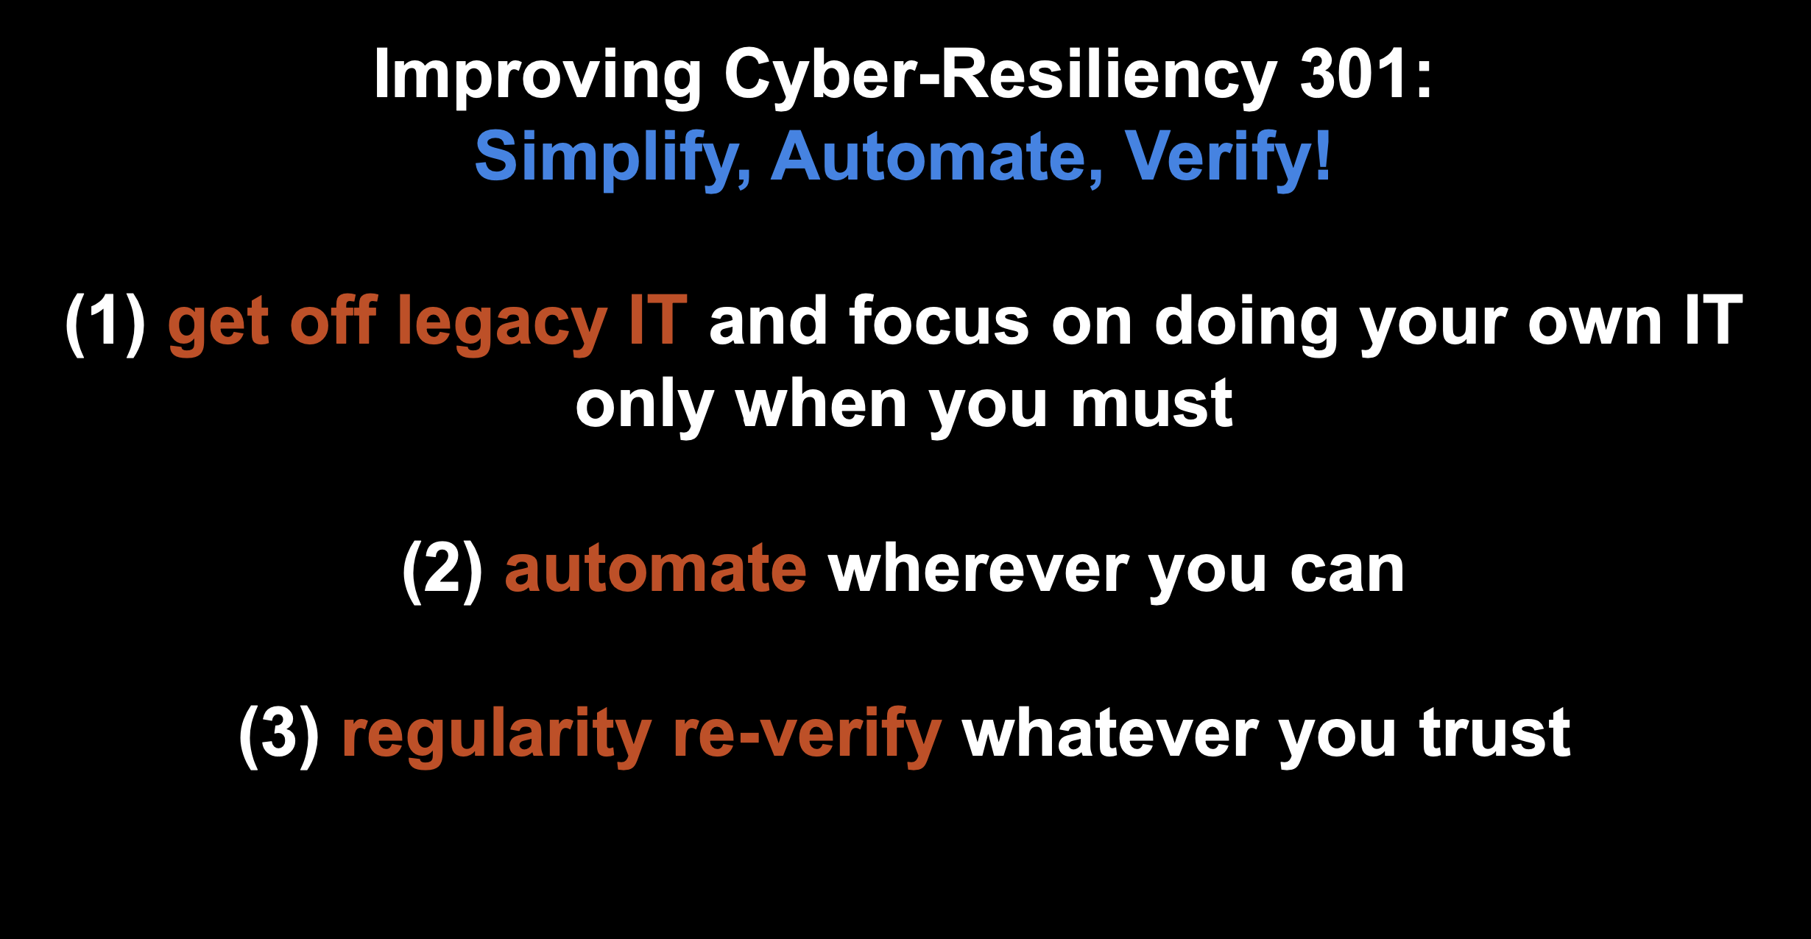
Long Term Strategic Trends and Technologies
Cyber-Resilience: Improvement

Slide 13
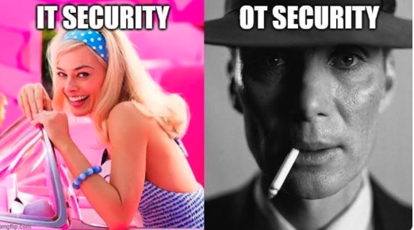

Slide 14
















Zero Trust Architecture with AI
Endpoints
Multi-Cloud
Knowing and Controlling Everyone and Everything on and off the Network
Ensures consistent security policy across the network, the cloud, and off-network
Mobile
Data
Center
Home
Campus
Call
Center
Factory
Operational
Technologies
Branch
Edge Compute
Partners
IoT
Customers

Slide 15


















Network Operations
Security Operations
Fortinet Security
Fabric
Appliance
Cloud Security
Broad
visibility and protection of the entire digital attack surface to better manage risk
Access & Endpoint Security
Virtual
FortiGuard
Threat Intelligence
Hosted
Integrated
solution that reduces management complexity and shares threat intelligence
Cloud
Secure Networking
Open Ecosystem
Agent
Automated
self-healing networks with AI-driven security for fast and efficient operations
Container
Notes:
XSP Segment comment for this slide:
Please mention that "The value of the FSF applies equally to the MSSP and MNO markets as it does to the enterprise. Fortinet MSSPs use the FSF to differentiate themselves in the market and launch new services beyond managed firewall. MNOs leverage it to apply security to 5G networks that is needed to drive 5G adoption by the enterprise as a private network, particularly Secure Networking and Cloud Security elements."
SMB comment: The FSF is relevant and resonates regardless of business size, from Small Businesses to the world’s largest Enterprises…

Slide 16








FortiAIOps
Artificial Intelligence with Machine Learning for the Security Fabric
Workflow
Dashboard/GUI
FortiOS
FortiAnalyzer
FortiAP
Incident API
SD-WAN
FortiManager
Stats API
FortiExtender
FortiAIOps is an artificial intelligence with machine learning (AI/ML) solution, that increases visibility, identifies anomalies, drives to root cause, and performs network operations center (NOC) optimizations.
FortiSwitch
Notes:
FortiAIOps is an Artificial Intelligence with Machine Learning (AI/ML) tool for network operations. Whether its WAN or LAN feeds, FortiAIOps correlates across the fabric and will produce insightful analysis, optimizations all presented in an easy to consume format - even available by API to integrate with 3rd Party applications for incidents and Statistics. FortiAIOps uses the power of the Fabric to deliver ease of use and tangible business overhead improvements.
**Note: SD-WAN support is roadmap at this time
Less Trouble Tickets =
More money to invest in key business initiatives
Leverage the Power of AI to:
Save time
Improve your responsiveness
Increase productivity

Slide 17








FortiPolicy
Remove implicit trust with Zero-trust policy automation
Realtime agentless discovery of traffic and workflows
Establish intent through machine learning
Automate segmentation / micro-segmentation security policies
Fortinet Security Fabric Integrated
Based on ShieldX Technology
Discovery of
applications & workflows
FortiGate
FortiPolicy
Create a connectivity map
Policy generation
FortiSwitch DC
FortiSwitch DC
FortiSwitch DC
User review/ acceptance
Policy enforcement
Workloads
Applications
On Premise Data Center
Traffic Information
Policies
Enforcement
Notes:
Different access levels across different users and devices
Contextual awareness/info on how best to deploy policies
Policy determines identity, place, device and user and then grants the right access

